Slide 1
Concurrency control in DDBMS

Slide 2
Introduction
Concurrency means executing multiple transaction at a time.
Concurrency is one of the most important features of distributed DBMS.
In DDBMS, Multiple users can access the database at a time, so concurrency control should be implemented in DDBMS.

Slide 3
Concurrency controlling techniques ensure that multiple transactions are executed simultaneously while maintaining the ACID properties of the transactions and serializability in the schedules
Concurrency control is done to get the desired
output in Distributed DBMS.

Slide 4
Advantages of Concurrency
Waiting time will be decreased.
Resources utilization will be increased.
Response time will be decreased.
Efficiency will be increased.

Slide 5
Challenges in concurrency
Simultaneously execution of transaction over shared data, data integrity and consistency problem may occur.
There are mainly three problems that can appear in concurrency computing system:
Lost update.
Uncommitted data.
Inconsistent retrieval.

Slide 6
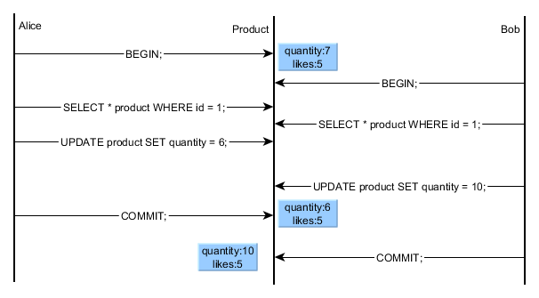
Lost Update
Lost update problem occurs when two users try to read and update the same data and one of the update is lost.

Slide 7
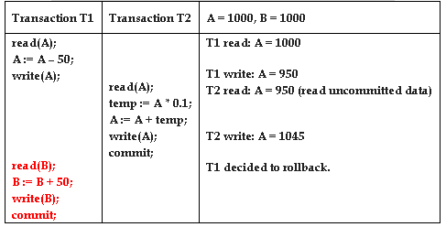
Uncommitted data
It occurs when two transactions T1 and T2 are executed concurrently and first transaction rolled backed after second accessed the uncommitted data.
Dirty read problem can occur as below:

Slide 8
Inconsistent retrieval
It appears due to the inconsistence of data while accessing the database.
If T1 needs to access data twice but T2 changed the data after T1 accessed once, T1 gets different data on second time.

Slide 9
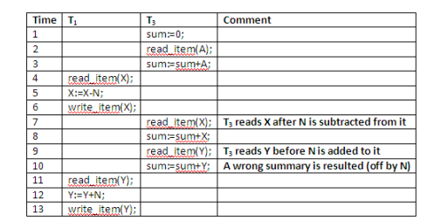
Inconsistent retrieval
We can shown in figure as below:

Slide 10
Concurrency control in DDBMS
Concurrency control is the activity of coordinating concurrent accesses to a database in a multiuser database management system (DBMS).
Concurrence control maintains the integrity and consistent while accessing more than one user.
In DBMS, two phase locking has been accepted as a standard solution and well defined mathematics is there.

Slide 11
Concurrency control in DDBMS
Concurrency control in database is provided to:
Enforce isolation among transactions.
Preserve database consistency through consistency preserving execution of transactions.
Resolve read-write and write-read conflicts

Slide 12
Concurrency control in DDBMS
Concurrence control algorithms in distributed DBMS are complex, hard to understand and difficult to implement.
Some of them are as follows:
Lock Based Concurrency Control
Time Stamp Ordering
Conflict graph.
Distributed optimistic concurrence control algorithm.

Slide 13
Lock Based Concurrency Control
Locking-based concurrency control protocols use the concept of locking data items.
A lock is a variable associated with a data item that determines whether read/write operations can be performed on that data item.
Generally, a lock compatibility matrix is used which states whether a data item can be locked by two transactions at the same time

Slide 14
Lock Based Concurrency Control
Types of Lock
Shared Lock (S)
A shared lock is also called a Read-only lock.
With the shared lock, the data item can be shared between transactions.
Exclusive Lock (X)
With the Exclusive Lock, a data item can be read as well as written.
This is exclusive and can't be held concurrently on the same data item.

Slide 15
Lock Based Concurrency Control
Any number of transactions can hold shared locks on an item
But if any transaction holds an exclusive on the item no other transaction may hold any lock on the item.
If a lock cannot be granted, the requesting transaction is made to wait till all incompatible locks held by other transactions have been released.
Lock requests are made to concurrency-control manager. Transaction can proceed only after request is granted.

Slide 16
Lock Based Concurrency Control-Starvation
Starvation is the situation when a transaction needs to wait for an indefinite period to acquire a lock.
Reasons for Starvation:
When waiting scheme for locked items is not properly managed
In the case of resource leak
The same transaction is selected as a victim repeatedly

Slide 17
One Phase Locking Protocol
In this method, each transaction locks an item before use and releases the lock as soon as it has finished using it.
This locking method provides for maximum concurrency but does not always enforce serializability.

Slide 18
Two phase locking
The transaction comprise of two phases.
The protocol assures serializability. It can be proven that the transactions can be serialized in the order of their lock points
Phases in two phase locking:
Growing Phase: In this phase transaction may obtain locks but may not release any locks.
Shrinking Phase: In this phase, a transaction may release locks but not obtain any new lock

Slide 19
Two phase locking
There are mainly three activities in two phase locking:
Lock acquisition.
Modification of data.
Release of data.
Lock manager controls the lock acquisition requests from transactions monitors.

Slide 20
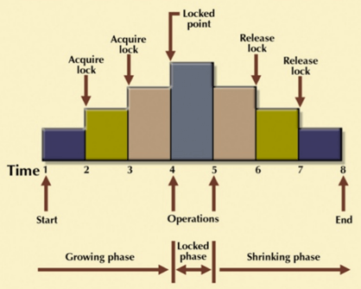
Two phase locking

Slide 21
Implementation of Locking
A lock manager can be implemented as a separate process to which transactions send lock and unlock requests.
The lock manager replies to a lock request by sending a lock grant messages (or a message asking the transaction to roll back, in case of a deadlock).
The requesting transaction waits until its request is answered.

Slide 22
Implementation of Locking
The lock manager maintains a data-structure called a lock table to record granted locks and pending requests.
The lock table is usually implemented as an in-memory hash table indexed on the name of the data item being locked.

Slide 23
Two phase locking-Types
Centralized two phase locking: In Centralized two Phase Locking, a single site is responsible for lock management process. It has only one lock manager for the entire DBMS.
Primary copy two-phase locking: Many lock managers are distributed to different sites. After that, a particular lock manager is responsible for managing the lock for a set of data items.
Distributed two phase locking: Lock managers are distributed to all sites. They are responsible for managing locks for data at that site.

Slide 24
Time Stamp Ordering
Use timestamps to determine the serializability order of transactions.
Used to order the transactions based on their Timestamps.
The order of transaction is nothing but the ascending order of the transaction creation.
The priority of the older transaction is higher that's why it executes first.
To determine the timestamp of the transaction, this protocol uses system time or logical counter.

Slide 25
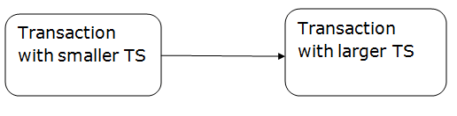
Time Stamp Ordering
A transaction created at 0002 clock time would be older than all other transactions that come after it.
For example, any transaction 'y' entering the system at 0004 is two seconds younger and the priority would be given to the older one.

Slide 26
Time Stamp Ordering
Let
TS(TI) denotes the timestamp of the transaction Ti.
R_TS(X) denotes the Read time-stamp of data-item X.
W_TS(X) denotes the Write time-stamp of data-item X.
1. Check the following condition whenever a transaction Ti issues a Read (X) operation:
If W_TS(X) >TS(Ti) then the operation is rejected.
If W_TS(X) <= TS(Ti) then the operation is executed.
Timestamps of all the data items are updated.

Slide 27
Time Stamp Ordering
Let
TS(TI) denotes the timestamp of the transaction Ti.
R_TS(X) denotes the Read time-stamp of data-item X.
W_TS(X) denotes the Write time-stamp of data-item X.
1. Check the following condition whenever a transaction Ti issues a Read (X) operation:
If W_TS(X) >TS(Ti) then the operation is rejected.
If W_TS(X) <= TS(Ti) then the operation is executed.
Timestamps of all the data items are updated.

Slide 28
Time Stamp Ordering
2. Check the following condition whenever a transaction Ti issues a Write(X) operation:
If TS(Ti) < R_TS(X) then the operation is rejected.
If TS(Ti) < W_TS(X) then the operation is rejected and Ti is rolled back otherwise the operation is executed.

Slide 29
Pros and Cons of Time Stamp Ordering
Pros:
Ensures serializability
Ensures freedom from deadlock that means no transaction ever waits.
Cons:
Schedule may not be recoverable and may not even be cascade- free.

Slide 30
Characteristics of Good Concurrency Protocol
Must be free from communication failures.
It must allow the parallel execution of transactions to achieve maximum concurrency.
Its storage mechanisms and computational methods should be modest to minimize overhead.
It must enforce some constraints on the structure of atomic actions of transactions.

Slide 31
Thank You

